Slide 1

CAPSTONE PROJECT
Ayushee Nigam (an2875)
Chengdao Yang (cy2512)
Dingran Lu (dl3228)
Emilia N. Dwyer (end2122)

Slide 2

Project Flow
Problem Statement
Unorganized data sets
80 different inputs formats(PDFs)
Data Modelling
Data Cleaning
Data Standardization
Programming & Results
Used PyPDF2, tabula, re, os, etc. libraries
Tableau-Data Visualization
Learned & leveraged Tableau for interactive Interface
Created ABR & HBR dashboards on Tableau
Dash & Machine Learning
High-end User Interface required
Future Predictions
Data Pre-processing
Consolidated 80 formats to 16
Converted PDFs to CSVs and merged them.
Issues- Only 14 months of data; Predictions were unrealistic
Still did ML & created interactive website using Dash
ABR – Antibiotics by Risk
HBR-Health by Risk
ML – Machine Learning

Slide 3
Business Problem & Key challenges
Problem Statement
Converting unorganized data in 80 different formats (PDFs) to csv or excel
High-end & interactive user interface required based on season, risk, month, year, drug, etc.
Issues Faced
Data was unorganized
While merging multi-page pdf, data was lost
Machine learning for future Predictions
80 formats were there, so consolidation was very difficult
Humongous data cleaning and pre-processing was required
Predictions were not realistic due to less data
Tried two different interactive UI which was a learning from scratch for us

Slide 4
Data Analysis & MODELLING
Data Pre-processing
Extracting the tables from each pdf to csv using libraries re, os, tabula, PyPDF2
Data Modelling
Assigning data to four categories of risk – Natural, low, moderate, high & ultra-high
Adding season, year and month as per client requirement
Output
A data frame after the above modelling. Master CSV was created from this.
Analyzing different formats of ABR and HBR and consolidating them
Data Merging as an input to data modelling stage
Data Cleaning
Bucketing to 16 categories of formats
Functionalizing based on year, month & season
Treatment success percentage was additionally computed for all quarters in each year, 2017 & 2018, as per client requirement.

Slide 5
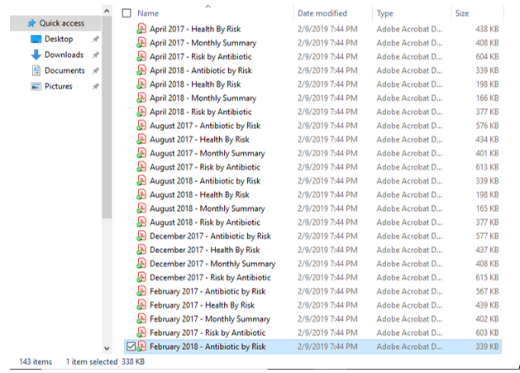
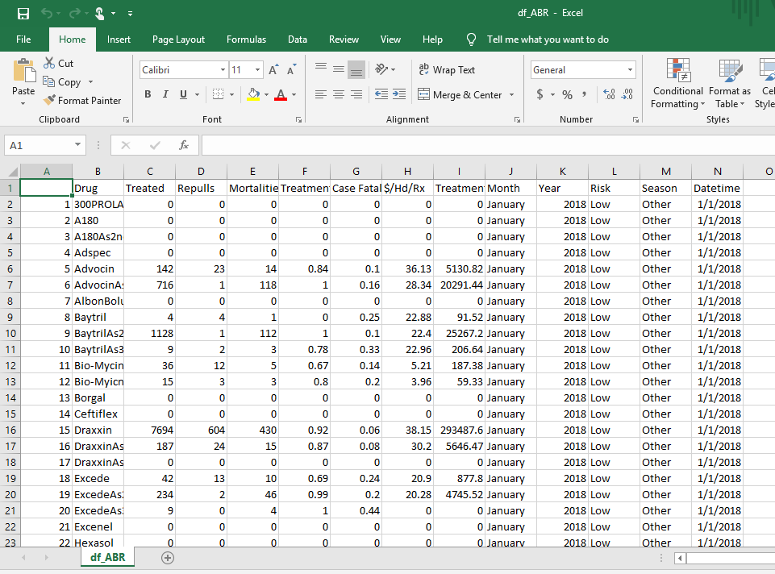
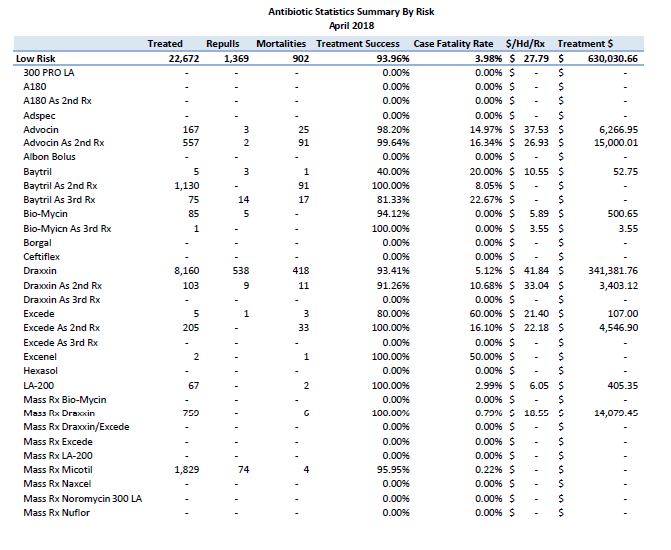
Results – 1st MILESTONE ACCOMPLISHED
Before
After
143 Items
1 Item, 1 page
Everything in 1 excel

Slide 6
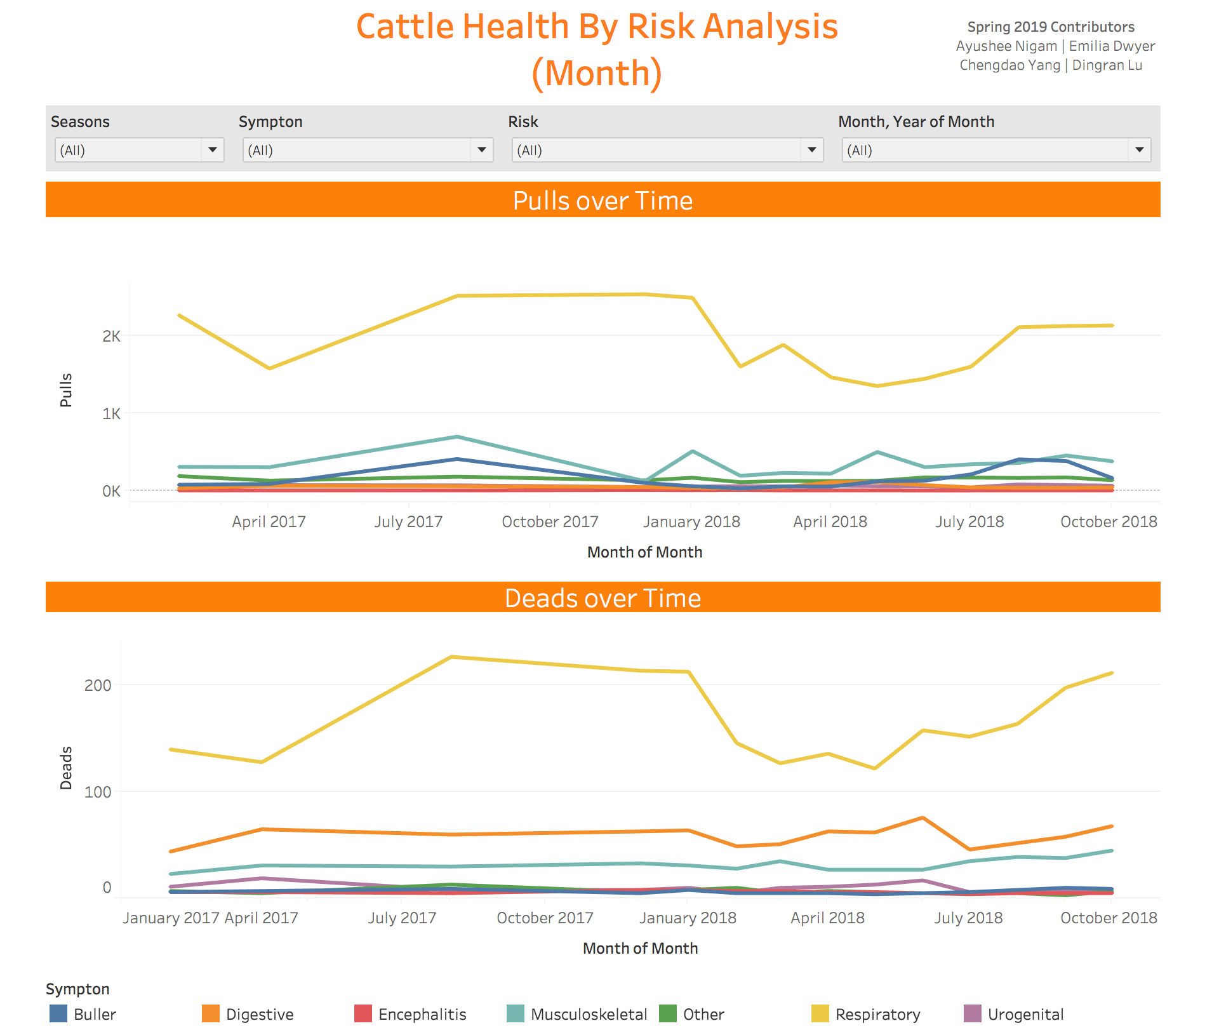
Tableau – Interactive user Interface (HBR)
Dashboard of Health by Risk (HBR)

Slide 7
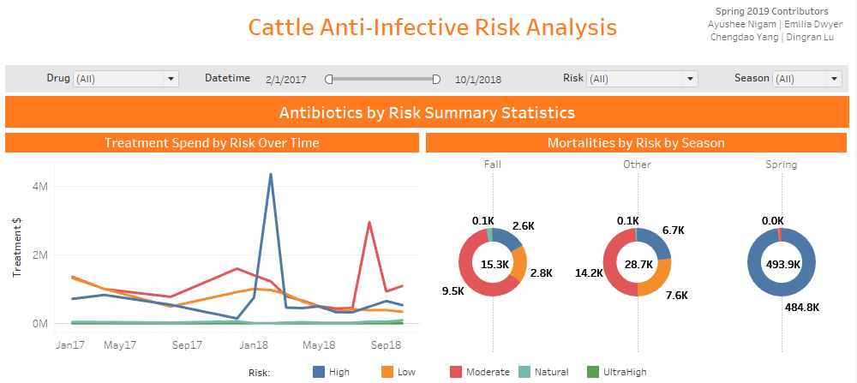
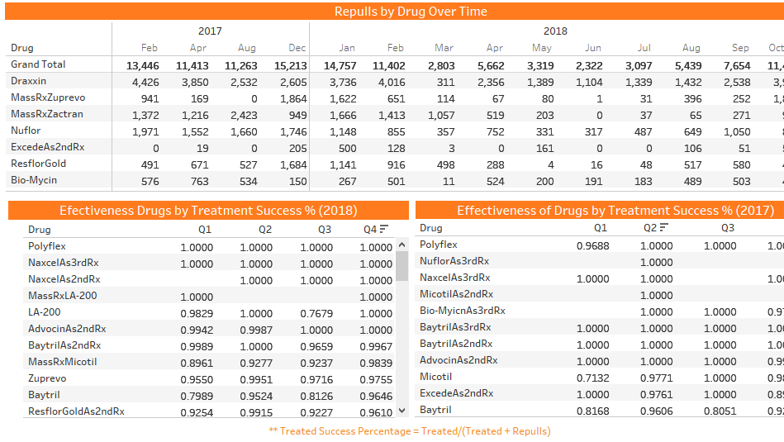
Tableau (ABR) - 2nd MILESTONE ACHIEVED
Dashboard of Antibiotics by Risk (ABR)

Slide 8
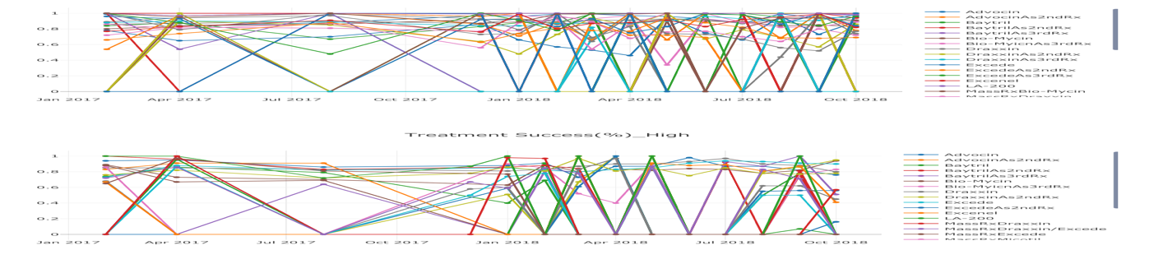
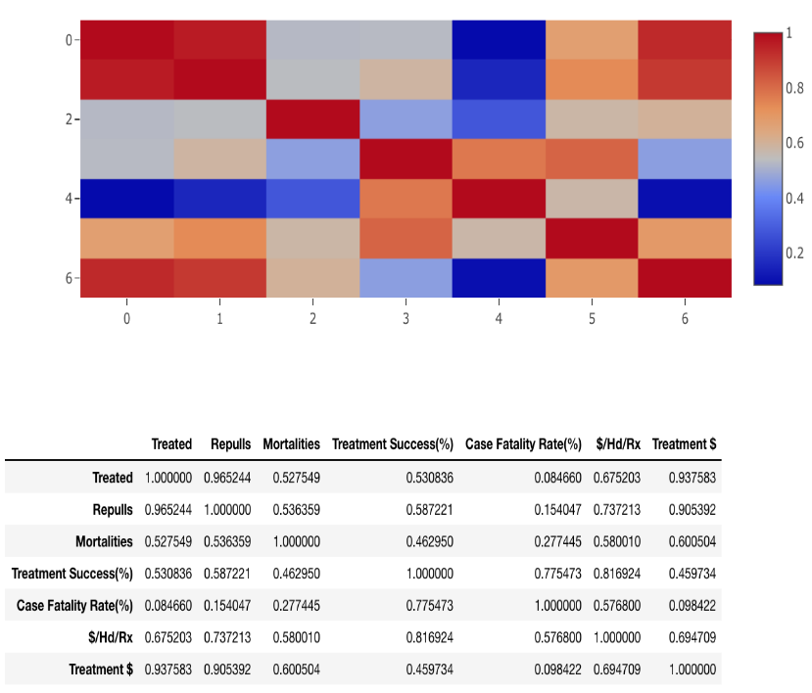
Machine Learning (ML) & Dash
Correlation Plot between treated, repulls, mortalities, success %, fatality rate, Dollars spent on treatment
Time Series Plot – showing trends of drugs’ treatment success percentage over 2017-18

Slide 9
Learnings & recommendation
Working in Agile way: Taking inputs from Business & incorporating it back to the model
Great exposure to Tableau, Machine Learning models and interactive website creation using Dash
Exposure to humungous amount of unorganized and unformatted data (in 80 different formats), enabling us to consolidate, clean, pre-process & model it
More data to have better machine learning predictions
Input format of the pdf to be among these 16 consolidated formats
Better organized input data
We have functionalized the input data on Interactive User Interface tool, Tableau. We would recommend all the stakeholders at Zoetis to install & use Tableau for better Data Visualization.

Slide 10

THANK YOU

